Slide 1

Koffect
Team members:
Jaran Chao
Project Advisor:
Professor William Hawkins III
Notes:
Hello, welcome to the Fall Design Presentation for CS 5001 Senior Design at the University of Cincinnati. Today I, as part of team ZJY, will be presenting the Koffect programming language project.

Slide 2
Team Members
Project Advisor
Jaran Chao
Professor William Hawkins III
Group Members
Notes:
The Koffect project is a solo project and I, Jaran Chao, am the only member of team ZJY.
The project advisor for this project is Professor William Hawkins III.

Slide 3
Project Advisor
Professor William Hawkins III
Group Members
Team Members
Jaran Chao
Notes:
The Koffect project is a solo project and I, Jaran Chao, am the only member of team ZJY.
The project advisor for this project is Professor William Hawkins III.

Slide 4
Group Members
Team Members
Project Advisor
Jaran Chao
Professor William Hawkins III
Notes:
The Koffect project is a solo project and I, Jaran Chao, am the only member of team ZJY.
The project advisor for this project is Professor William Hawkins III.

Slide 5
Koffect is a research language that explores the realm of context-oriented programming focusing on its applications to general purpose programming. This innovative project seeks to address the inherent challenges posed by implicit contexts in programming, ranging from code correctness to resource management to the creation of domain-specific languages. Koffect takes inspiration from many languages with similar features such as algebraic effects/coeffects, implicit parameters, and context receivers from languages such as Kotlin, Scala, Ocaml, Haskell, Koka, Effekt, and Eff. By doing so, Koffect aims to build on the strengths of these languages while innovatively addressing the challenges associated with context management in programming.
Project Abstract

Slide 6
Project Abstract
Koffect is a research language that explores the realm of context-oriented programming focusing on its applications to general purpose programming. This innovative project seeks to address the inherent challenges posed by implicit contexts in programming, ranging from code correctness to resource management to the creation of domain-specific languages. Koffect takes inspiration from many languages with similar features such as algebraic effects/coeffects, implicit parameters, and context receivers from languages such as Kotlin, Scala, Ocaml, Haskell, Koka, Effekt, and Eff. By doing so, Koffect aims to build on the strengths of these languages while innovatively addressing the challenges associated with context management in programming.
Notes:
Koffect is a research language that explores the realm of context-oriented programming focusing on its applications to general purpose programming. It seeks to address the inherent challenges posed by implicit contextual information commonly found in programming. This can range from code correctness in context dependent domains such as mathematical proofs or asynchronous code, to resource and memory management, to the creation and maintenance of domain specific languages. [PAUSE] The Koffect language takes inspiration from many languages, the foremost being Kotlin’s context/multiple receivers. However, other inspirations are implicit parameters from Haskell and Scala as well as algebraic effect/coeffects from languages such as Ocaml, Koka, Effekt, and Eff. Koffect aims to build on the strengths of these languages while tackling the challenges and tradeoffs associated with context oriented programming.

Slide 7
Koffect aims to build upon the foundations laid out by previous languages by emphasizing the context-oriented programming aspects. To help reduce cognitive load, Koffect aims to be as explicit as possible in context management.
Furthermore, Koffect aims to introduce the concept that contexts are not just additive to their environment but are also subtractive. Contexts may not only add more functionality, but they may restrict the functionality. The aim with this new concept is to have the language assist in ensuring the correctness of a program.
Intellectual Merits
Notes:
Koffect is a research language that explores the realm of context-oriented programming focusing on its applications to general purpose programming. It seeks to address the inherent challenges posed by implicit contextual information commonly found in programming. This can range from code correctness in context dependent domains such as mathematical proofs or asynchronous code, to resource and memory management, to the creation and maintenance of domain specific languages. [PAUSE] The Koffect language takes inspiration from many languages, the foremost being Kotlin’s context/multiple receivers. However, other inspirations are implicit parameters from Haskell and Scala as well as algebraic effect/coeffects from languages such as Ocaml, Koka, Effekt, and Eff. Koffect aims to build on the strengths of these languages while tackling the challenges and tradeoffs associated with context oriented programming.

Slide 8
Intellectual Merits
Koffect aims to build upon the foundations laid out by previous languages by emphasizing the context-oriented programming aspects. To help reduce cognitive load, Koffect aims to be as explicit as possible in context management.
Furthermore, Koffect aims to introduce the concept that contexts are not just additive to their environment but are also subtractive. Contexts may not only add more functionality, but they may restrict the functionality. The aim with this new concept is to have the language assist in ensuring the correctness of a program.
Notes:
Koffect is a research language that explores the realm of context-oriented programming focusing on its applications to general purpose programming. It seeks to address the inherent challenges posed by implicit contextual information commonly found in programming. This can range from code correctness in context dependent domains such as mathematical proofs or asynchronous code, to resource and memory management, to the creation and maintenance of domain specific languages. [PAUSE] The Koffect language takes inspiration from many languages, the foremost being Kotlin’s context/multiple receivers. However, other inspirations are implicit parameters from Haskell and Scala as well as algebraic effect/coeffects from languages such as Ocaml, Koka, Effekt, and Eff. Koffect aims to build on the strengths of these languages while tackling the challenges and tradeoffs associated with context oriented programming.

Slide 9
With Koffect’s focus on context-oriented programming, it will allow for code written in Koffect to better model real world contextual dependent situations with minimal boilerplate. This will allow for developers to better model the business logic of their application, improving development speed as well as developer happiness to help bring better and safer software into the world. Furthermore, it would help developers to break into heavily contextual problem spaces that were previously difficult to model in other programming languages.
Broader Impacts

Slide 10
Broader Impacts
With Koffect’s focus on context-oriented programming, it will allow for code written in Koffect to better model real world contextual dependent situations with minimal boilerplate. This will allow for developers to better model the business logic of their application, improving development speed as well as developer happiness to help bring better and safer software into the world. Furthermore, it would help developers to break into heavily contextual problem spaces that were previously difficult to model in other programming languages.
Notes:
Koffect is a research language that explores the realm of context-oriented programming focusing on its applications to general purpose programming. It seeks to address the inherent challenges posed by implicit contextual information commonly found in programming. This can range from code correctness in context dependent domains such as mathematical proofs or asynchronous code, to resource and memory management, to the creation and maintenance of domain specific languages. [PAUSE] The Koffect language takes inspiration from many languages, the foremost being Kotlin’s context/multiple receivers. However, other inspirations are implicit parameters from Haskell and Scala as well as algebraic effect/coeffects from languages such as Ocaml, Koka, Effekt, and Eff. Koffect aims to build on the strengths of these languages while tackling the challenges and tradeoffs associated with context oriented programming.

Slide 11
Software Developer
Library Maintainer
I want the language to be expressive and powerful enough to express my complex business logic and business solution. Preferably in an idiomatic, elegant, and concise manner.
I want the language features to be composable such that libraries can be used together without causing conflicts, bugs, and undefined behavior.
User Stories 1

Slide 12
Library Maintainer
I want the language features to be composable such that libraries can be used together without causing conflicts, bugs, and undefined behavior.
User Stories 1
Software Developer
I want the language to be expressive and powerful enough to express my complex business logic and business solution. Preferably in an idiomatic, elegant, and concise manner.

Slide 13
User Stories 1
Software Developer
Library Maintainer
I want the language to be expressive and powerful enough to express my complex business logic and business solution. Preferably in an idiomatic, elegant, and concise manner.
I want the language features to be composable such that libraries can be used together without causing conflicts, bugs, and undefined behavior.

Slide 14
Software Maintainer
User
I want the language to have good tooling for creating maintainable and scalable code solutions and documentation solutions.
I expect programs and applications written in Koffect to be stable and consistent. Behavior of the program/application should be well-defined.
User Stories 2

Slide 15
User
I expect programs and applications written in Koffect to be stable and consistent. Behavior of the program/application should be well-defined.
User Stories 2
Software Maintainer
I want the language to have good tooling for creating maintainable and scalable code solutions and documentation solutions.

Slide 16
User Stories 2
Software Maintainer
User
I want the language to have good tooling for creating maintainable and scalable code solutions and documentation solutions.
I expect programs and applications written in Koffect to be stable and consistent. Behavior of the program/application should be well-defined.

Slide 17
Software Developer
I want the language to have compatibility with multiple platforms so that Koffect code can be run from multiple different hardware architectures. Furthermore, I want the language to have a good multiplatform story to allow for Koffect to be utilized for many different applications.
User Stories 3

Slide 18
User Stories 3
Software Developer
I want the language to have compatibility with multiple platforms so that Koffect code can be run from multiple different hardware architectures. Furthermore, I want the language to have a good multiplatform story to allow for Koffect to be utilized for many different applications.

Slide 19
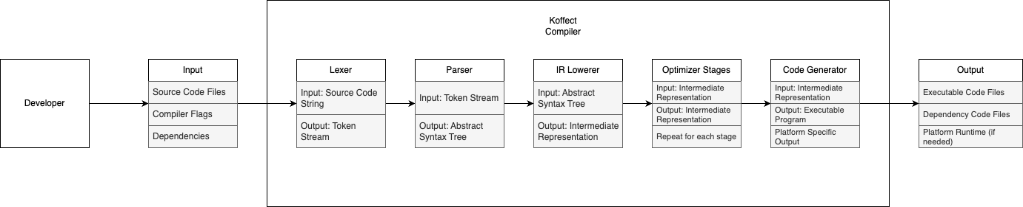
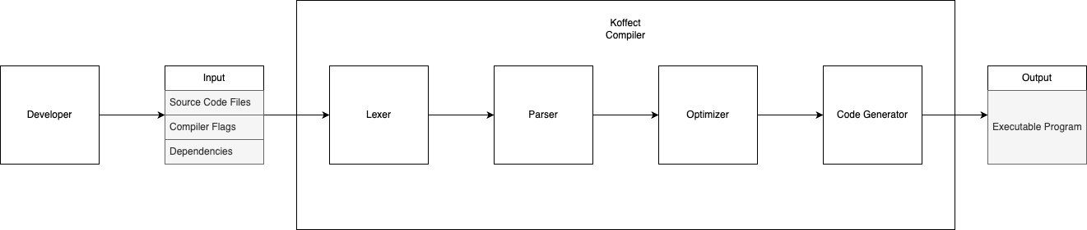
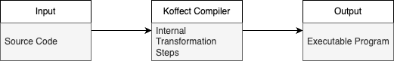
210
Design Diagrams

Slide 20
210
Design Diagrams
Notes:
0 is a overall high level look at the structure of the Koffect project

Slide 21
210
Design Diagrams
Notes:
1 is a more detailed look, specifying the separate steps inside the Koffect compiler

Slide 22
Design Diagrams
210
Notes:
2 is the most detailed look, specifying how each internal step integrates with each other [EXPLAIN STEPS]

Slide 23
Design Overview
For the Koffect language, there are 2 main components: the compiler and the runtime.
The compiler is broken up into 4 main stages:
Lexer: the lexer takes in a source program and outputs a token stream describing the individual “words” that make up the Koffect language.
Parser: the parser converts the linear token stream into a hierarchical structure, encoding language semantics.
IR lower and Optimizer: the IR lower lowers the program to convert high level constructs into simpler constructs. These lower-level constructs may be easier for the optimizer to understand and remove redundant constructs.
Code Generator: the code generator generates the low-level instructions to be understood by the target runtime.
For the final demonstration, the Koffect language will only target a single runtime, the Koffect Virtual Machine.
Notes:
2 is the most detailed look, specifying how each internal step integrates with each other [EXPLAIN STEPS]

Slide 24
Time Constraint
Economic Constraint
Professional Constraint
Developing a programming language is complex, involving a compiler, a runtime, a comprehensive standard library, and community support. The project acknowledges the time required for maturity, emphasizing the need for various tooling, including developer and build/distribution tools.
The project aims to leverage free and open-source frameworks and libraries to reduce development effort, especially for later milestones like the Language Server Protocol. The choice of an open-source license (GNU GPLv3) may restrict the use of other open-source software and emphasizes acknowledgment rather than paywall-based distribution.
The project creator lacks formal professional experience in programming language development, compilers, and interpreters. Success in this endeavor would serve as professional credibility. The ad-hoc and subjective nature of design and implementation concepts may require seeking input and perspectives from various sources.
Project Constraints
Notes:
This project has 3 major constraints:
Time
Economic
Professional

Slide 25
Economic Constraint
Professional Constraint
The project aims to leverage free and open-source frameworks and libraries to reduce development effort, especially for later milestones like the Language Server Protocol. The choice of an open-source license (GNU GPLv3) may restrict the use of other open-source software and emphasizes acknowledgment rather than paywall-based distribution.
The project creator lacks formal professional experience in programming language development, compilers, and interpreters. Success in this endeavor would serve as professional credibility. The ad-hoc and subjective nature of design and implementation concepts may require seeking input and perspectives from various sources.
Project Constraints
Time Constraint
Developing a programming language is complex, involving a compiler, a runtime, a comprehensive standard library, and community support. The project acknowledges the time required for maturity, emphasizing the need for various tooling, including developer and build/distribution tools.
Notes:
This project has 3 major constraints:
Time
Economic
Professional

Slide 26
Professional Constraint
The project creator lacks formal professional experience in programming language development, compilers, and interpreters. Success in this endeavor would serve as professional credibility. The ad-hoc and subjective nature of design and implementation concepts may require seeking input and perspectives from various sources.
Project Constraints
Time Constraint
Economic Constraint
Developing a programming language is complex, involving a compiler, a runtime, a comprehensive standard library, and community support. The project acknowledges the time required for maturity, emphasizing the need for various tooling, including developer and build/distribution tools.
The project aims to leverage free and open-source frameworks and libraries to reduce development effort, especially for later milestones like the Language Server Protocol. The choice of an open-source license (GNU GPLv3) may restrict the use of other open-source software and emphasizes acknowledgment rather than paywall-based distribution.
Notes:
This project has 3 major constraints:
Time
Economic
Professional

Slide 27
Project Constraints
Time Constraint
Economic Constraint
Professional Constraint
Developing a programming language is complex, involving a compiler, a runtime, a comprehensive standard library, and community support. The project acknowledges the time required for maturity, emphasizing the need for various tooling, including developer and build/distribution tools.
The project aims to leverage free and open-source frameworks and libraries to reduce development effort, especially for later milestones like the Language Server Protocol. The choice of an open-source license (GNU GPLv3) may restrict the use of other open-source software and emphasizes acknowledgment rather than paywall-based distribution.
The project creator lacks formal professional experience in programming language development, compilers, and interpreters. Success in this endeavor would serve as professional credibility. The ad-hoc and subjective nature of design and implementation concepts may require seeking input and perspectives from various sources.
Notes:
This project has 3 major constraints:
Time
Economic
Professional

Slide 28
All aspects of the Koffect compiler and virtual machine are written purely in the Kotlin programming language. Koffect’s repository currently relies only on the Kotlin standard library and Gradle as the build system. There are no third-party external dependencies.
Future plans for Koffect may require the use of LLVM and/or GraalVM as backend compilation targets to allow for modular compilation to many different platforms.
Technologies

Slide 29
Technologies
All aspects of the Koffect compiler and virtual machine are written purely in the Kotlin programming language. Koffect’s repository currently relies only on the Kotlin standard library and Gradle as the build system. There are no third-party external dependencies.
Future plans for Koffect may require the use of LLVM and/or GraalVM as backend compilation targets to allow for modular compilation to many different platforms.
Notes:
Koffect is a research language that explores the realm of context-oriented programming focusing on its applications to general purpose programming. It seeks to address the inherent challenges posed by implicit contextual information commonly found in programming. This can range from code correctness in context dependent domains such as mathematical proofs or asynchronous code, to resource and memory management, to the creation and maintenance of domain specific languages. [PAUSE] The Koffect language takes inspiration from many languages, the foremost being Kotlin’s context/multiple receivers. However, other inspirations are implicit parameters from Haskell and Scala as well as algebraic effect/coeffects from languages such as Ocaml, Koka, Effekt, and Eff. Koffect aims to build on the strengths of these languages while tackling the challenges and tradeoffs associated with context oriented programming.

Slide 30
Research
Implementation
Documentation
Research into many different aspects of programming languages has improved design cohesion and revealed clearer design paths.
More research will be conducted to better improve both the design and implementation of the Koffect language.
Implementation of specific subsystem prototypes has proven successful in giving a clearer structure of the compiler.
Promotion of the core prototypes to be ready for production are essential for the final demonstration. These core subsystems include the Lexer, Parser, Code Generator, and Virtual Machine.
Documentation of all project related research in design notes has served both as a timeline of the evolution of Koffect and unofficial documentation for the language.
Git and GitHub will continue to be used to document all project related changes.
Review of Progress

Slide 31
Implementation
Documentation
Implementation of specific subsystem prototypes has proven successful in giving a clearer structure of the compiler.
Promotion of the core prototypes to be ready for production are essential for the final demonstration. These core subsystems include the Lexer, Parser, Code Generator, and Virtual Machine.
Documentation of all project related research in design notes has served both as a timeline of the evolution of Koffect and unofficial documentation for the language.
Git and GitHub will continue to be used to document all project related changes.
Review of Progress
Research
Research into many different aspects of programming languages has improved design cohesion and revealed clearer design paths.
More research will be conducted to better improve both the design and implementation of the Koffect language.

Slide 32
Documentation
Documentation of all project related research in design notes has served both as a timeline of the evolution of Koffect and unofficial documentation for the language.
Git and GitHub will continue to be used to document all project related changes.
Review of Progress
Research
Implementation
Research into many different aspects of programming languages has improved design cohesion and revealed clearer design paths.
More research will be conducted to better improve both the design and implementation of the Koffect language.
Implementation of specific subsystem prototypes has proven successful in giving a clearer structure of the compiler.
Promotion of the core prototypes to be ready for production are essential for the final demonstration. These core subsystems include the Lexer, Parser, Code Generator, and Virtual Machine.

Slide 33
Review of Progress
Research
Implementation
Documentation
Research into many different aspects of programming languages has improved design cohesion and revealed clearer design paths.
More research will be conducted to better improve both the design and implementation of the Koffect language.
Implementation of specific subsystem prototypes has proven successful in giving a clearer structure of the compiler.
Promotion of the core prototypes to be ready for production are essential for the final demonstration. These core subsystems include the Lexer, Parser, Code Generator, and Virtual Machine.
Documentation of all project related research in design notes has served both as a timeline of the evolution of Koffect and unofficial documentation for the language.
Git and GitHub will continue to be used to document all project related changes.

Slide 34
Cohesive Design
Project Scope
To have a cohesive and flexible design, a great deal of research into many different aspects of programming language theory, design, and implementation. This balance of cohesion and flexibility required weighing of tradeoffs, deep understanding of underlying principles, and making tough decisions.
Initial time constraints were underestimated and unforeseen setbacks in design and implementation caused a reevaluation of project deliverables for final demonstration. This tough decision was made to ensure that the best possible design path was taken for the Koffect language.
Challenges

Slide 35
Project Scope
Initial time constraints were underestimated and unforeseen setbacks in design and implementation caused a reevaluation of project deliverables for final demonstration. This tough decision was made to ensure that the best possible design path was taken for the Koffect language.
Challenges
Cohesive Design
To have a cohesive and flexible design, a great deal of research into many different aspects of programming language theory, design, and implementation. This balance of cohesion and flexibility required weighing of tradeoffs, deep understanding of underlying principles, and making tough decisions.

Slide 36
Challenges
Cohesive Design
Project Scope
To have a cohesive and flexible design, a great deal of research into many different aspects of programming language theory, design, and implementation. This balance of cohesion and flexibility required weighing of tradeoffs, deep understanding of underlying principles, and making tough decisions.
Initial time constraints were underestimated and unforeseen setbacks in design and implementation caused a reevaluation of project deliverables for final demonstration. This tough decision was made to ensure that the best possible design path was taken for the Koffect language.

Slide 37
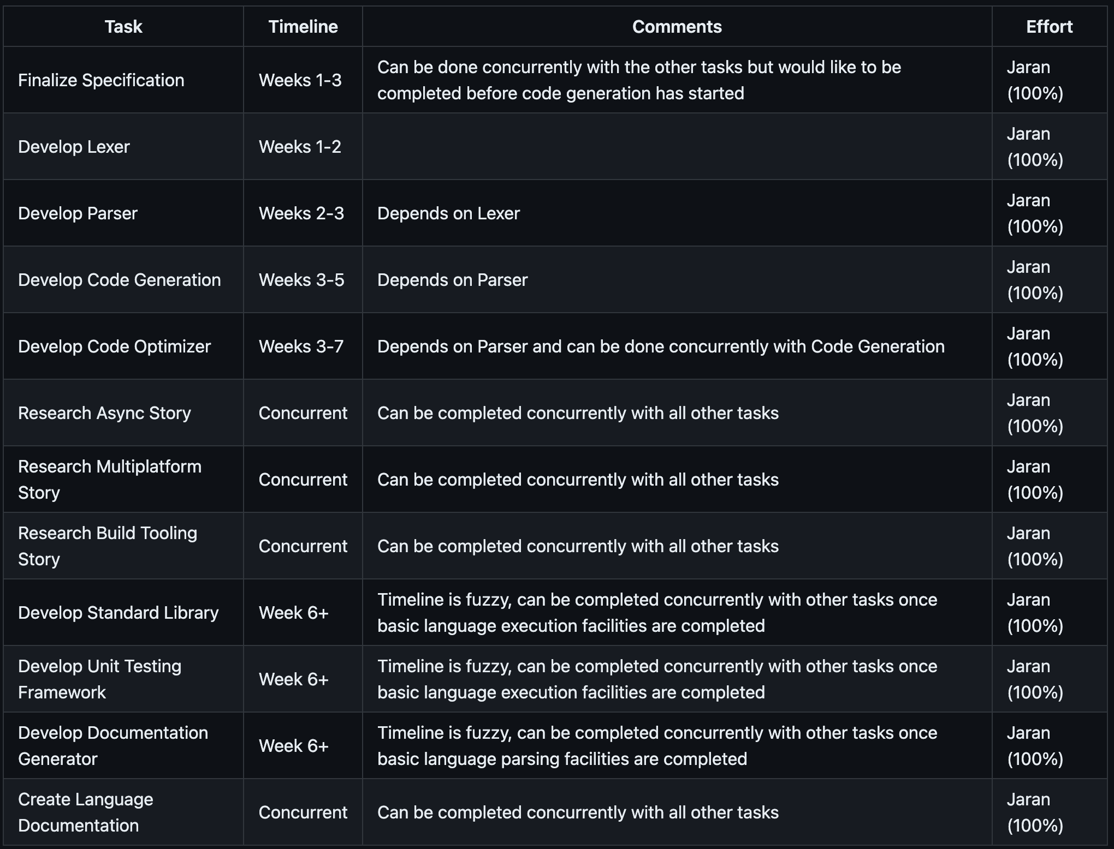
As I, Jaran Chao, am the only member of my team, I will be responsible for all work pertaining to the Koffect language.
Division of Work
Notes:
As I, Jaran Chao, am the only member of my team, I will be responsible for all work pertaining to the Koffect language.

Slide 38
Division of Work
As I, Jaran Chao, am the only member of my team, I will be responsible for all work pertaining to the Koffect language.
Notes:
As I, Jaran Chao, am the only member of my team, I will be responsible for all work pertaining to the Koffect language.

Slide 39
The primary demo of the language will be a start from scratch to fully functioning program demo. This demo may be multiple different code files depicting the multiple different features and paradigms supported by Koffect. The main code file will be demonstrating the context-oriented features of Koffect.
Expected Demo

Slide 40
Expected Demo
The primary demo of the language will be a start from scratch to fully functioning program demo. This demo may be multiple different code files depicting the multiple different features and paradigms supported by Koffect. The main code file will be demonstrating the context-oriented features of Koffect.

Slide 41

Notes:
Thank you for viewing this presentation on the Koffect language. If you have any questions, please refer to the project github for the best ways of getting in contact.

